Slide 1
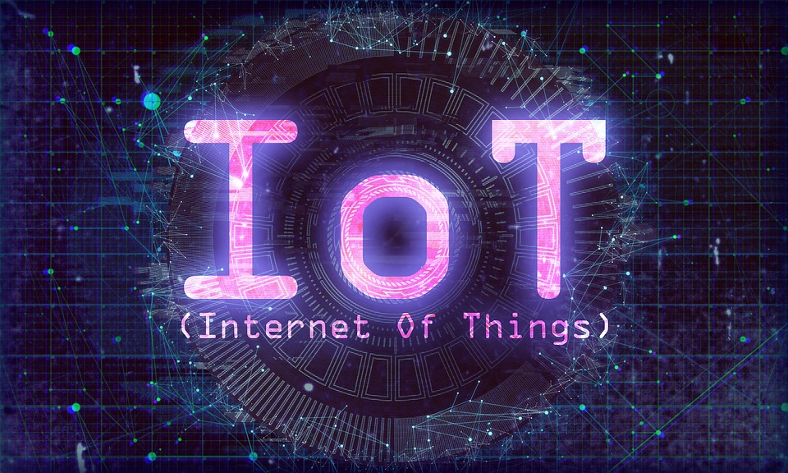

Slide 2
Plan for the workshop
Introduction
What is IOT?
Raspberry pi Introduction
Python basics
Reading and writing data from Raspberry’s GPIO pins
Introduction to Internet of Things
Create, read ,write channels in ThingSpeak
Response To the channel Values accoedingly .

Slide 3
Introduction
The Internet of Things (IoT) is the network of physical devices, vehicles, home appliances, and other items embedded with electronics, software, sensors, actuators, and connectivity which enables these things to connect and exchange data.
creating opportunities for more direct integration of the physical world into computer-based systems, resulting in efficiency improvements, economic benefits, and reduced human exertions.

Slide 4
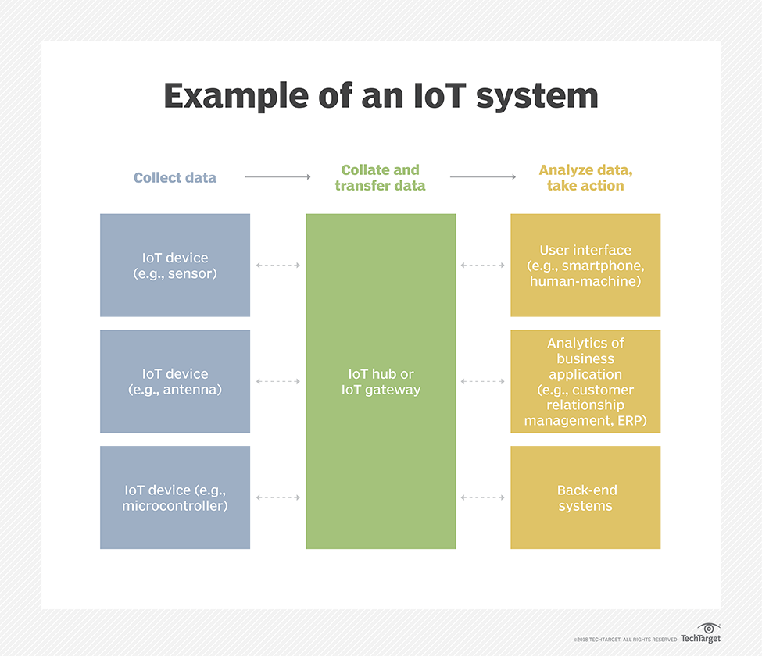

Slide 5

Python is an interpreted high-level programming language for general-purpose programming.
Created by Guido van Rossum and first released in 1991, Python has a design philosophy that emphasizes code readability, notably using significant whitespace.
It provides constructs that enable clear programming on both small and large scales.
Python supports multiple programming paradigms, including object-orientened and has a large and comprehensive standard library.

Slide 6
Why python ?
>Embeddable: Python allows integration with other languages i.e. It is possible to put our code in other programming language like C++ etc.
>Portable: Python code is portable there is no need to change the code for different machines. You can run one code in many machines
>Free and open source: Python is a Free/Libre open source software(FLOSS). It source code is freely available to public you can download it, change it and distribute it.
>Library support: Python supports large standard libraries. Installation of the libraries are easy, and it save the time
>Community supports: Python has already got its huge response in the market ,thus provides many users grouped into community to support the advancements further.

Slide 7
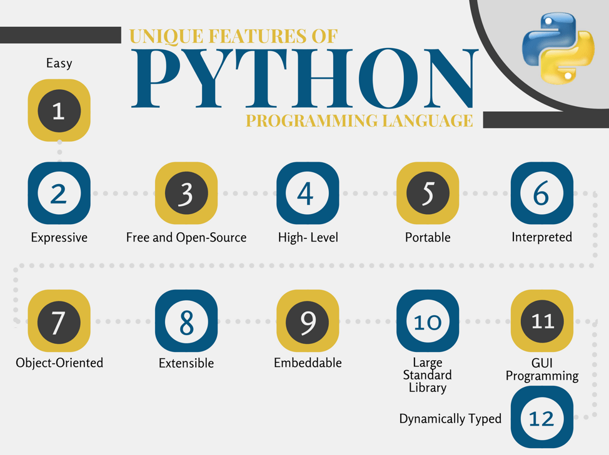

Slide 8

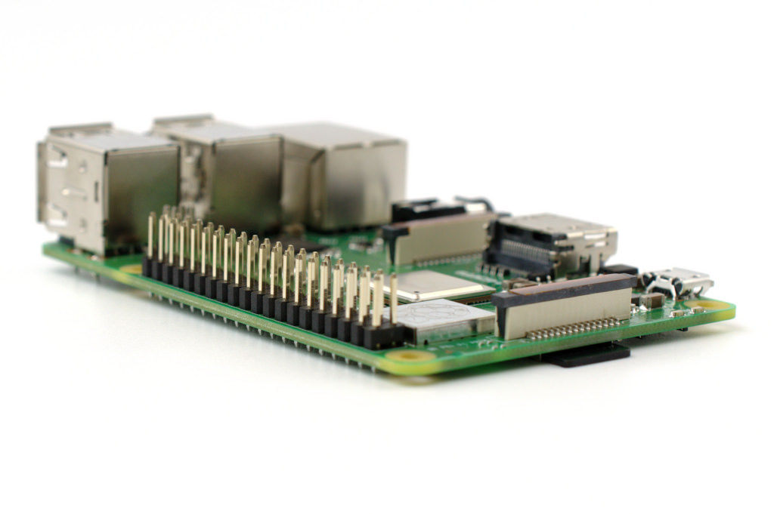
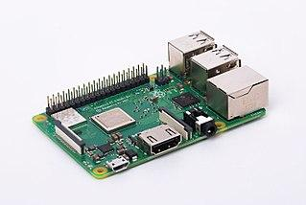

Slide 9
What is the Raspberry Pi?
• Affordable credit-card sized computer
• Plugs into a computer monitor or TV
• Uses standard keyboard and mouse
• Can browse the internet and play HD video
• Can also interact with the outside world!

Slide 10
Raspberry pi 3 B
Specification:
SoC: Broadcom BCM2837 (roughly 50% faster than the Pi 2)
CPU: 1.2 GHZ quad-core ARM Cortex A53 (ARMv8 Instruction Set)
GPU: Broadcom VideoCore IV @ 400 MHz
Memory: 1 GB LPDDR2-900 SDRAM
USB ports: 4
Network: 10/100 MBPS Ethernet, 802.11n Wireless LAN, Bluetooth 4.0

Slide 11
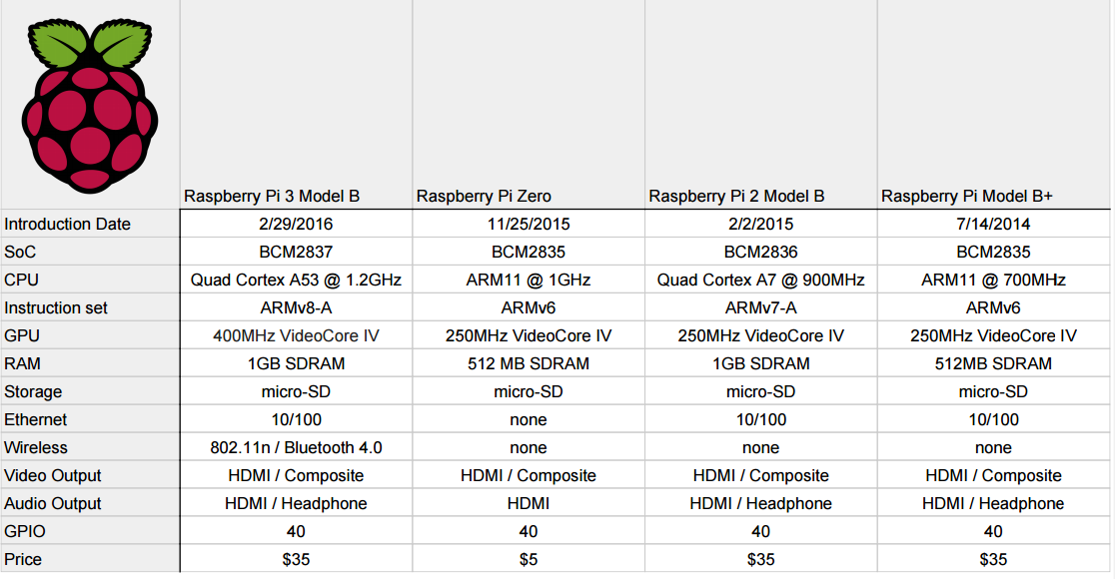

Slide 12
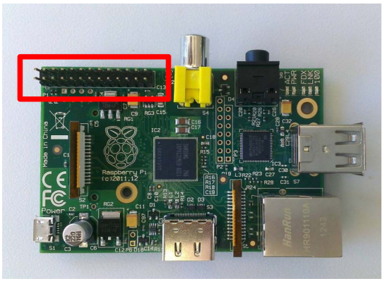
General Purpose Input/Output (GPIO)
• General Purpose Input/Output (GPIO) is a generic pin on a chip whose behavior can be controlled by the user at run time.

Slide 13
The GPIO connector are of different types of connection:
– True GPIO (General Purpose Input Output) pins that you can use to turn LEDs on and off etc.
– I2C interface pins that allow you to connect hardware modules with just two control pins
– SPI interface with SPI devices, a similar concept to I2C but uses a different standard
– Serial Rx and Tx pins for communication with serial peripherals

Slide 14
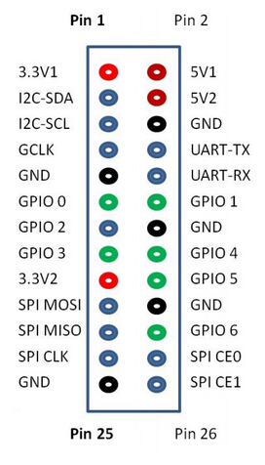
Pin Diagram for GPIO
• GPIO pins can be used as both digital outputs and digital inputs.
• Output: turn a particular pin HIGH or LOW. – Setting it HIGH sets it to 3.3V,setting it LOW sets it to 0V.
• Input: detect the pin being at HIGH or LOW
– we can connect switches and simple sensors to a pin and check whether it is open or closed (that is, activated or not) or to read the sensor values

Slide 15
USES:
Can be used to analyze data
– New MATLAB integration allows users to run scheduled MATLAB code on data coming into ThingSpeak Can be used to act on data
– E.g. Tweet a message when the temperature in your backyard reaches 32 degrees

Slide 16
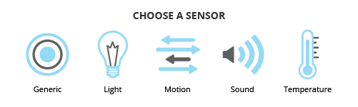
Sensors and Transducers
a device which detects or measures a physical property and records, indicates, or otherwise responds to it, records it, indicates, or otherwise responds to it.
a device which detects or
measures a physa device which detects or measures a physical property and records, indicates, or otherwise responds to itical property and records, indicates, or otherwise responds to it

Slide 17
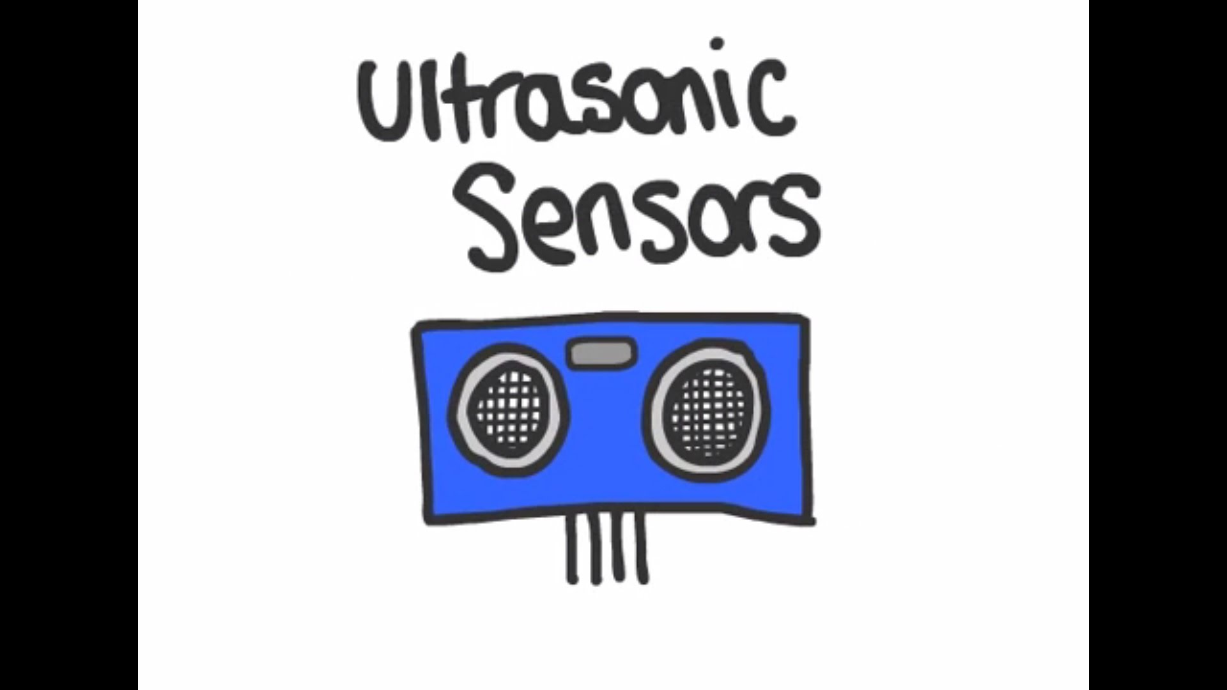
Ultrasonic Sensor
Distances are measured by ultrasonic waves
The sensor head emits an ultrasonic wave and receives the wave reflected back from the target.
Ultrasonic Sensors measure the distance to the target by measuring the time between the emission and reception.

Slide 18
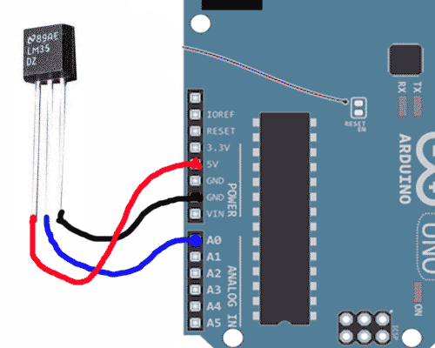
Temperature Sensor-LM35
LM35 is an integrated analog temperature sensor whose electrical output is proportional to Degree Centigrade.
Sensor does not require any external calibration or trimming to provide typical accuracies.
0.5°C accuracy guarantee-able (at a25°C)

Slide 19

Free online data aggregation platform
– Typically used to collect data from sensors (“Things”)
– Provides instant visualization of the data
– Popular for people experimenting in IoT – Has more than 50,000 users

Slide 20
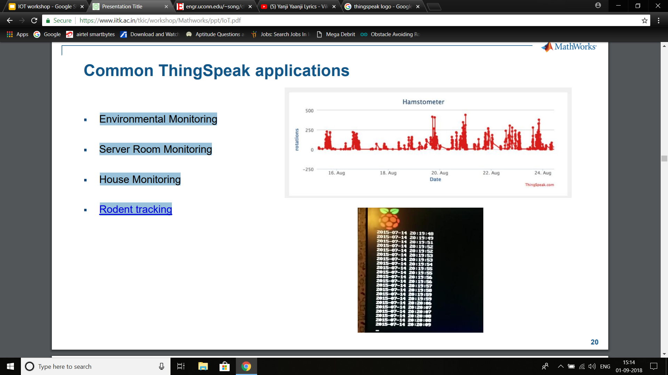
Common ThingSpeak applications
Environmental Monitoring
Server Room Monitoring
House Monitoring
Rodent tracking

Slide 21
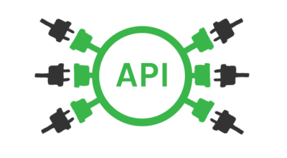
API
a set of functions and procedures that allow the creation of applications which access the features or data of an operating system, application, or other service.
defines the correct way for a developer to write a program that requests services from an operating system (OS) or other application.

Slide 22
thingSpeak APIs:
Out of numerous APIs being offered by the thingSpeak Forum we use only the read and write APIs
READ APIs:
Passing our read API as as a parameter we could read whatever data we want and reproduce it anywhere
WRITE APIs:
Passing the write API Key as a parameter and our data structured in JSON format we could write into fields on the thingspeak channel.

